Slide 1








{onestic}
Software Designer & Dared Coder
Jose Manuel Orts Carrion
@jortsc

Slide 2

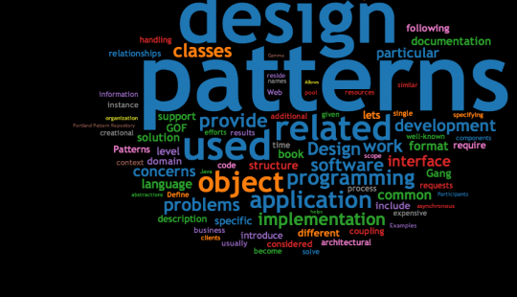

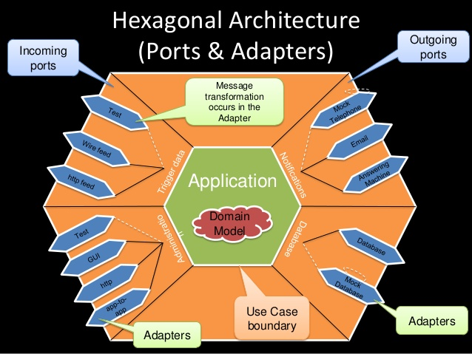


Code Quality
as
Quality of Life
@jortsc

Slide 3
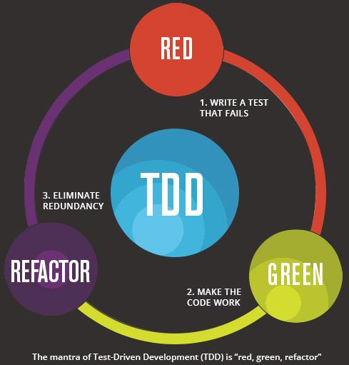
For us, quality of life came when we changed our implementation design paradigm
to TDD
@jortsc

Slide 4
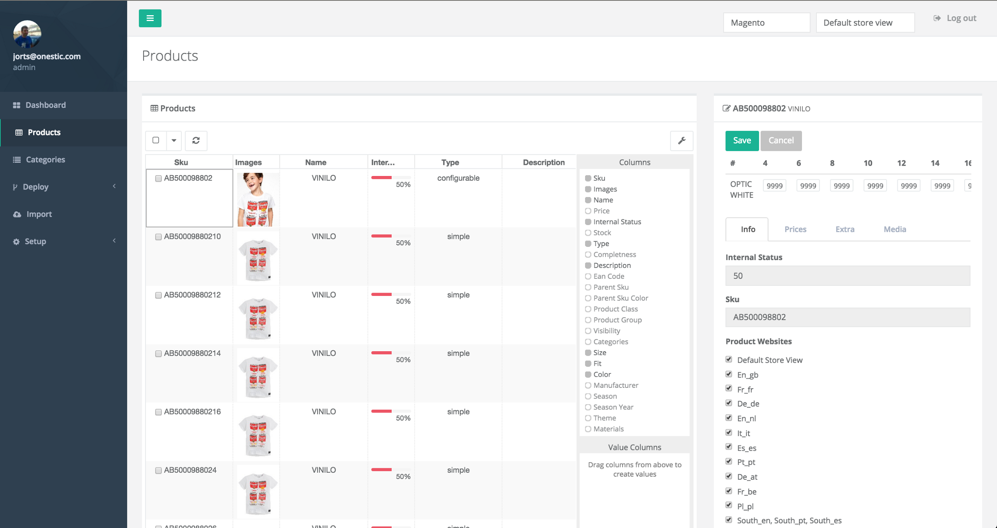
All of this is represented in our amazing product SmartIE.
Place your screenshot here
@jortsc

Slide 5
Powerful Filter System
OData - The best way to REST An open protocol to allow the creation and consumption of queryable and interoperable RESTful APIs in a simple and standard way
take:200
skip:0
page:1
pageSize:200
filter[logic]:and
filter[filters][0][field]:channel_id
filter[filters][0][operator]:eq
filter[filters][0][value]:1
@jortsc

Slide 6
http://api.smartie.d3v.on3sticdev/product/?take=200&skip=0&page=1&pageSize=200&filter%5Blogic%5D=and&filter%5Bfilters%5D%5B0%5D%5Bfield%5D=channel_id&filter%5Bfilters%5D%5B0%5D%5Boperator%5D=eq&filter%5Bfilters%5D%5B0%5D%5Bvalue%5D=1&filter%5Bfilters%5D%5B1%5D%5Bfield%5D=view_id&filter%5Bfilters%5D%5B1%5D%5Boperator%5D=eq&filter%5Bfilters%5D%5B1%5D%5Bvalue%5D=1&filter%5Bfilters%5D%5B2%5D%5Bfield%5D=sku&filter%5Bfilters%5D%5B2%5D%5Boperator%5D=contains&filter%5Bfilters%5D%5B2%5D%5Bvalue%5D=al20011&filter%5Bfilters%5D%5B3%5D%5Blogic%5D=or&filter%5Bfilters%5D%5B3%5D%5Bfilters%5D%5B0%5D%5Bfield%5D=fit&filter%5Bfilters%5D%5B3%5D%5Bfilters%5D%5B0%5D%5Boperator%5D=eq&filter%5Bfilters%5D%5B3%5D%5Bfilters%5D%5B0%5D%5Bvalue%5D=27&filter%5Bfilters%5D%5B3%5D%5Bfilters%5D%5B1%5D%5Bfield%5D=fit&filter%5Bfilters%5D%5B3%5D%5Bfilters%5D%5B1%5D%5Boperator%5D=eq&filter%5Bfilters%5D%5B3%5D%5Bfilters%5D%5B1%5D%5Bvalue%5D=29&filter%5Bfilters%5D%5B3%5D%5Bfilters%5D%5B2%5D%5Bfield%5D=fit&filter%5Bfilters%5D%5B3%5D%5Bfilters%5D%5B2%5D%5Boperator%5D=eq&filter%5Bfilters%5D%5B3%5D%5Bfilters%5D%5B2%5D%5Bvalue%5D=30&filt….
An amazing query string
@jortsc

Slide 7
take:200
skip:0
page:1
pageSize:200
filter[logic]:and
filter[filters][0][field]:channel_id
filter[filters][0][operator]:eq
filter[filters][0][value]:1
filter[filters][1][field]:view_id
filter[filters][1][operator]:eq
filter[filters][1][value]:1
filter[filters][2][field]:sku
filter[filters][2][operator]:contains
filter[filters][2][value]:al20011
filter[filters][3][logic]:or
filter[filters][3][filters][0][field]:fit
filter[filters][3][filters][0][operator]:eq
filter[filters][3][filters][0][value]:27
filter[filters][3][filters][1][field]:fit
filter[filters][3][filters][1][operator]:eq
filter[filters][3][filters][1][value]:29
In a human readable version
@jortsc

Slide 8
Filter query string comes to API and then FilterGet class process that query and turns it into a perfect SQL snippet
channel_id = '1' AND view_id = '1' AND sku LIKE '%al20011%' AND type = ‘configurable’ AND label LIKE ‘%shirt’ AND status = ‘ready’ AND stock > 0 AND ( fit = '27' OR fit = '29' OR fit = '30' OR fit = '32' OR fit = '34' OR fit = '36' OR fit = 'LO' OR fit = 'RE' ) LIMIT 0, 200
All of
that ends mounting a SQL query
@jortsc

Slide 9

and finally SmartIE V.2
{onestic}
We had to move from Kendo UI
@sergiorael

Slide 10

In an ideal world grids never have to do server-side pagination

Slide 11
No pagination? We have some customers with more than 130.000 products!

Slide 12

1º try: UI Grid

Slide 13





2º try: AG-Grid
+
Developer
Niall Crosby

Slide 14

2º try: AG-Grid

Slide 15
and finally SmartIE V.2
I want to have control!
I want to be powerful!
UI
I want to be DRY and clean!
I want to sleep at night!

Slide 16
and finally SmartIE V.2
I want to have control!
I want to be powerful!
UI
I want to be DRY and clean!
I want to sleep at night!

Slide 17
gridOptions
I want to have control!
{
columnDefs: {},
datasource: {},
enableServerSideSorting: true,
enableServerSideFilter: true,
angularCompileRows: true,
[...]
}

Slide 18
columnDefs
I want to have control!
{
headerName: ‘Name’,
field: ‘name’,
hide: false,
width: 150,
filter: ‘text’,
valueGetter: function(params){},
cellRenderer: function(params) {},
filterParams: {}
}

Slide 19
datasource
params
I want to have control!
{
pageSize: 200,
getRows: function(params) {
}
}
{
startRow: 0,
endRow: 200,
sortModel: [],
filterModel: {},
failCallback: function(){}
successCallback: function() {}
}

Slide 20
gridOptions (flexibility)
I want to have control!
Can be feeded with functions
Columns set per client
Powerful grid api
Can be taken from a service
self.gridOptions.api.selectAll();
self.gridOptions.api.setFilterModel(model);
self.gridOptions.api.exportDataAsCsv(params);
self.gridOptions.api.refreshView();
self.gridOptions.api.setDatasource(datasource);

Slide 21
external filters
I want to have control!
var filterApi = self.gridOptions.api.getFilterApi(‘country’);
filterApi.selectNothing();
filterApi.selectValue(‘Ireland’);
filterApi.selectValue(‘Great Britain’);
self.gridOptions.api.onFilterChanged();

Slide 22

it’s show time!
Place your screenshot here

Slide 23
and finally SmartIE V.2
I want to have control!
I want to be powerful!
UI
I want to be DRY and clean!
I want to sleep at night!

Slide 24
1.000
I want to be powerful!
Trying to have
rows per page

Slide 25
Tips
Options
I want to be powerful!
Angular directives !== cells
Try to avoid images inside the grid
If you do, they must be as small as possible!
The best choice is to have the images resized in a background task
At least put an image resize proxy like thumbor
http://localhost:8888/unsafe/100x0/http://www.waterfalls.ca/images/Waterfall.jpg

Slide 26
and finally SmartIE V.2
I want to have control!
I want to be powerful!
UI
I want to be DRY and clean!
I want to sleep at night!

Slide 27
Tips
I want to be DRY and clean!
Services are reusable
Services are testable
self.gridOptions = GridService.configure({
context: context,
attributes: attributes.data,
pagination: 200,
[...]
});

Slide 28
and finally SmartIE V.2
I want to have control!
I want to be powerful!
UI
I want to be DRY and clean!
I want to sleep at night!

Slide 29
Tests
I want to sleep at night!
TDD ... when possible
using karma with mocha, chai and sinon
var spy = sinon.spy(HttpService, ‘http’);
ProductService.getProducts();
spy.should.have.been.calledWith(‘GET’, ‘/product’);

Slide 30
Tests
I want to sleep at night!
using karma with mocha, chai and sinon
describe(‘getColumnDefs()’, function() {
var columns;
beforeEach(function() {
columnDefs = GridService.getColumndefs(attributes);
});
it(‘should have at least…’, function() {
expect(columnDefs[0]).to.contain.all.keys([‘headerName’, ‘field’, ‘colId’, ‘hide’]);
});
});

Slide 31
THANKS!
Any questions?
You can find me at @sergiorael & srael@onestic.com

